Slide 1

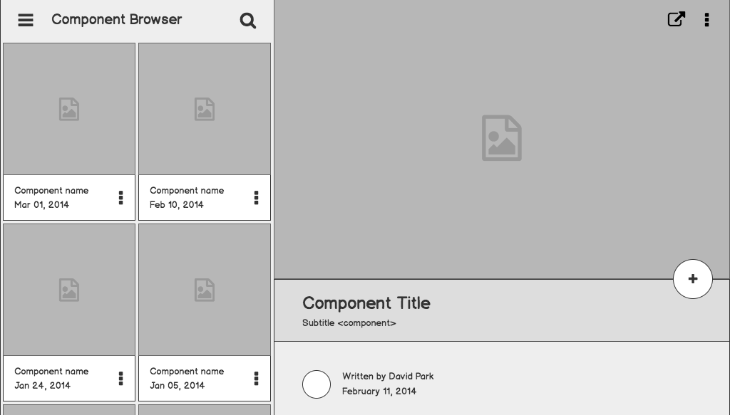

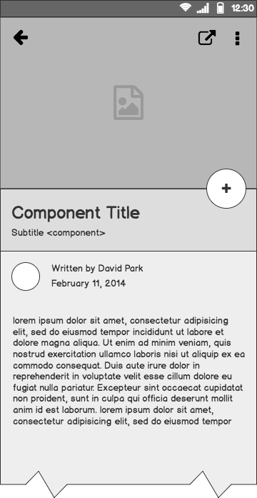
Git and Bash
Every Developer’s toolkit
Instructor: Kyle Rose

Slide 2
Why use the terminal?
You can navigate your entire drive
You can copy files to other locations
You can move or delete files
You can install programs or files
You can rename files
You can edit documents
You can control Git
You can set up certificates (SSH)
You can run programs
And a lot more!
Everything can be done on your terminal.

Slide 3
What is terminal/Bash?
If you type in a command, the terminal should reply in some way, whether a success message or even just a lack of error message is feedback.
Bash is a powerful scripting language that interacts with the terminal. This does not come default on Windows Operating Systems, so we have to install it.
In Persevere schools, we will use Git Bash to run a Bash profile, and we can even make it connect to the default windows terminal.
A terminal is the part you see that takes input and spits out feedback of what it did.

Slide 4
Common Bash Commands
pwd (present working directory)
When you type this command in the terminal, the terminal will display the path of the folder you are currently inside of, from the root directory (~)
ls [flags](list)
When you type ls in the terminal, the terminal will display what files or folders you have in the directory that you are in. Adding -a after will display hidden folders.

Slide 5
Common Bash Commands
cd (change directory)
You use cd in order to navigate to a new folder or directory. You can use the entire PATH for the directory (ex. cd ~/Desktop/homework/assignments), or use where you currently are to start the navigation. (ex. If you are in the homework folder, you can navigate by just typing cd assignments).
You can also navigate outside the folder you are in by typing a ‘..‘

Slide 6
Common Bash Commands
mkdir [directoryName](make directory)
This command makes a folder in your current directory named whatever you put after the command.
The terminal does not respect spaces, and as such the industry does not use spaces in naming conventions. If you type
mkdir my homework The terminal will create two folders: one named “my” and one named “homework”.

Slide 7
Common Bash Commands
touch [fileName]
This command creates a new file in your current working directory. The naming convention is the same as with folders, no spaces!
nano [fileName]
The nano command allows you to edit a file that you name in your present directory or the navigated directory specified. If the file does not exist, it will create a new one and open the editor.

Slide 8
Common Bash Commands
rm [flags][fileName] (remove)
This command will delete a file in your current working directory.
rmdir [directoryName] (remove directory)
This command with remove a directory so long as the folder is empty. If the folder is not empty, it will tell you.

Slide 9
Common Bash Commands
mv [filePath][destinationPath] (move/rename)
This command allows you to move/rename a file to the destination. If the destination is the same directory, you can just change the name.
cp [fileNames][destinationPath] (copy)
To copy files to a given directory, use this command with the names of the files, followed by a destination path as the last command.

Slide 10
Git Commands
Git is a version control system that allows for sharing code and collaboration.
It is important to at least know basic git commands for the industry.
There can be several servers with git, but the commands are the same.
Github and GitLab are two common ones.

Slide 11
Common Git Commands
All git commands will start with the word git or gh.
That tells bash your commands are going to be using a version control.
git init
If you are building a repository from scratch, make a directory with some basic files (readme, html, css) and navigate to the enclosing folder, use this command and it will start a repository on your computer.

Slide 12

Common Git Commands
To start a Github repository is to go into your github account and click the green “New” button at the top. You will go through naming the project, add a readme if you haven’t already created one, and keep it public so that other people can check out what you’re making.
Once you create the repo, you have two ways of linking your local computer to it. Cloning and using upstream.

Slide 13
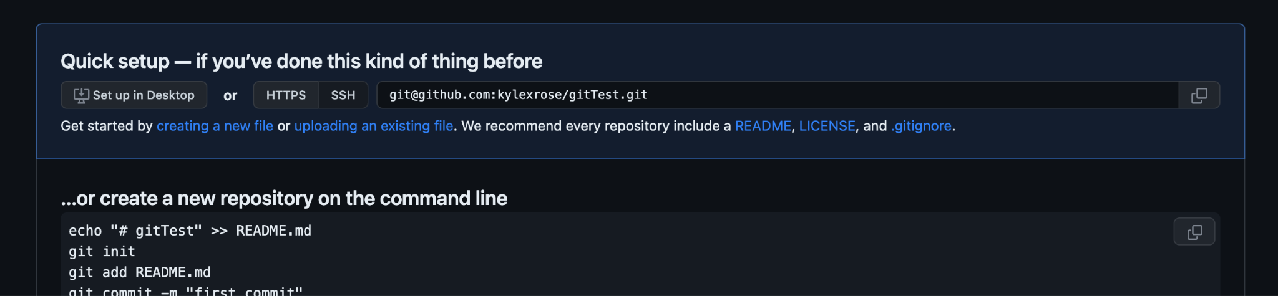
The Upstream Route
If you already have a folder in your local environment (which the way we will be preparing repos should be) then after initializing git with git init, then you will copy the link given on you github repo you created
git remote add origin <link here>

Slide 14
The Clone Route
If you want to start a repo from scratch and you don’t need resources or folders from class, it is a bit more straightforward. Create the repository on Github the same way, but this time, you will navigate to where you want your project and use:
git clone <link here>

Slide 15
Git Commits
Commits are basically snapshots of changes made to a git repository. As we build out new features and bug fixes, we will want to commit each of those changes as they happen, ideally when we know the program is running without problem.
When we commit, we are basically allowing ourselves to go back to that point of the project if needed. Every commit has a record of what was changed as well as who changed it (if you are working with a group of developers).

Slide 16
Common Git Commands
Now that you are linked to your Github repository online, you can work with your project, knowing that you will have backups in the case of a bug or a code failure. Within your workspace folder, make new files, edit them and add things as you would like, and after saving your changes, we will want to commit those changes.
The command for this is git add <file name>. If you don’t want to go hunting for all the files you changed and you want them all on the same commit, just type git add .

Slide 17
Common Git Commands
We can check if our commits are “staged” with the command git status.
The terminal will then list files changed that it found and they will either be green (staged) or red (unstaged). Whatever is staged will be included in the commit.
To commit the staged changes, use the command git commit -m ‘<a comment about the commit here>’. You will want to try to be specific about what has changed in the commit so if you need to go back, you’ll have an idea of the commit you want to go back to or before.

Slide 18
Common Git Commands
Now we have a commit saved, we need to push it up to the repository on github. You can do this now that you are linked to it by
git push origin master.

Slide 19
What is terminal/Bash?
Today we talked about:
The importance of using the terminal.
Common bash commands
Setting up Github repositories
Common Github commands
Review

Slide 20
Git and Bash
Every Developer’s toolkit
Instructor: Kyle Rose

